Slide 1

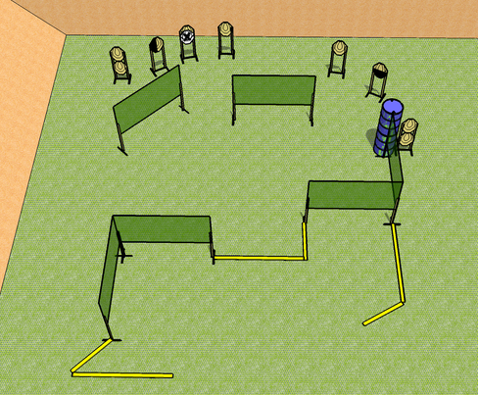
 | Dothan Practical Shooters – USPSA Match From the WAC Course Designer : WAC Design Team Bay: B3
Round Count 18 rounds 9 IPSC
Equipment List 10 wall feet 1 50%, 1 left diag 8 targets (7 + 1NS)

Slide 2
From the WAC
Written Stage Briefing
Scoring: Fixed Time Rounds: 18
Targets: 9 IPSC
Handgun start position: anywhere inside the shooting area, wrists below belt. Handgun is loaded and holstered.
PCC start position: anywhere inside the shooting area, stock on belt. Loaded carbine is held with both hands, safety on.
Stage Procedure: on the audible start signal, engage targets as they become available from within the shooting area.
String time: 8 seconds.

